Slide 1


Security for
MAD
MODERN APPLICATION DEVELOPMENT
Marcos Santos
Application Security Manager

Slide 2
Insecure code, whether developed in-house or by third parties, is a leading source of data breaches. In fact, 46% of data breaches are tied to application vulnerabilities, according to the 2022 Verizon Data Breach Investigations
Source: https://www.businesswire.com/news/home/20230621580393/en/Brinqa-Announces-Strategic-Partnership-with-Checkmarx-Delivering-the-Industry%E2%80%99s-Most-Complete-Application-Security-Solution

Slide 3
Over 92% of applications contain open-source libraries that may contain hidden vulnerabilities like Log4j, OpenSSL, or Struts, which are exploited by attackers,” said Nic Surpatanu, chief product officer, Tanium
Source: https://www.businesswire.com/news/home/20230622497697/en/Tanium-Platform-Advances-Threat-Identification-Capabilities-and-Enhances-Endpoint-Reach

Slide 4
AMONG THE SECTORS THAT MOST REGISTERED ATTACKS ARE:
Education / Research― 2.507;
Government / Military ― 1.725;
Healthcare ― 1.684;
Communications ― 1598;
ISP/MSP ― 1.312;
Finance / Banking ― 1.212;
Utilities― 1.185;
Retail / Wholesale― 1.079;
Leisure / Hospitality ― 997;
Manufacturing ― 992.
Source: https://tiinside.com.br/27/04/2023/brasil-teve-aumento-de-1-em-ataques-ciberneticos-no-primeiro-trimestre-de-2023/

Slide 5
TODAY’S CHAT
What is MAD?
Main features
Challenges Encountered
New Risks
How to mitigate?
Integrations
Checkmarks
Q&A

Slide 6
WHAT IS MAD?
Modern application development is an approach that enables you to innovate rapidly by using cloud-native architectures with loosely coupled microservices, managed databases, AI, DevOps support, and built-in monitoring.
Subsequently modern applications use continuous integration and delivery (CI/CD) technologies and processes to improve system reliability.

Slide 7
WHAT IS MAD?
Hybrid
Flexible
Digital
Multiple Devices
timing
Legalization
Rigid Structures
transitional models
Client/Server Architecture
User Interface
Application Source Code
Microservices A
Microservices B
Data Access
Container Code
API code
External services
Open Source Software
Data Store
Infra as Code

Slide 8
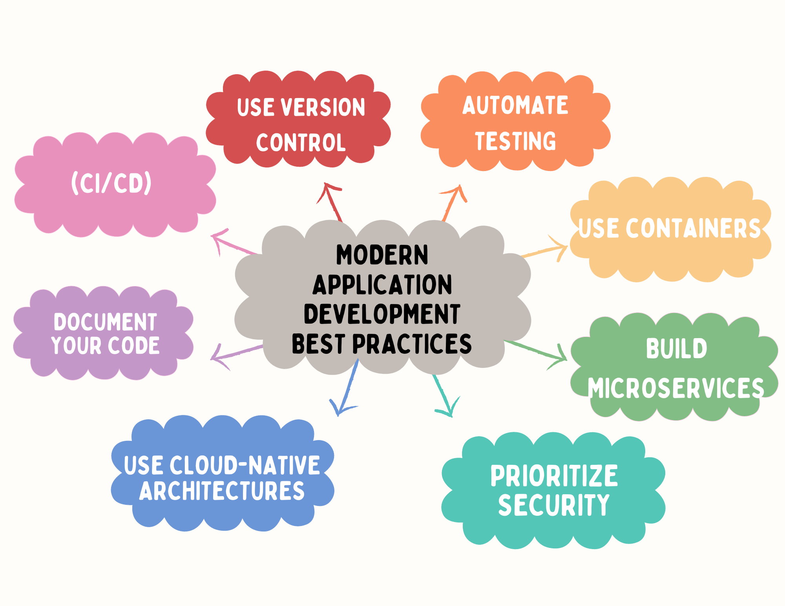
WHAT IS MAD?

Slide 9
MAIN FEATURES
Componentization through services
Organization around the business
Product-based structure.
not in projects
Considering the broad growth and also the adoption of MAD in various business sectors, we have some characteristics that come to the fore when we talk about Modern Application Development
Componentization? Each component is a service
Infrastructure Automation?
Application designed to fail?
Smart endpoints
and
Dumb Pipes
Decentralized Governance
Decentralization in Data Management
Infrastructure Automation
Designed To Fail
Evolutionary Design

Slide 10
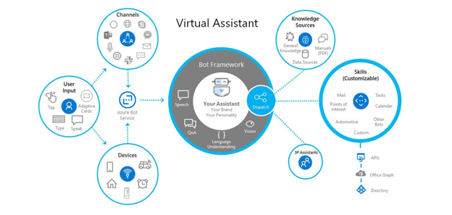
CHALLENGES ENCOUNTERED
Communication — How front ends communication with back-end services, and how back-end services communicate with each other.
Resiliency — How services in your distributed architecture respond in less-than-ideal scenarios due to the in-process, out-process network communications of microservices architecture.
Distributed Data — How do you query data or implement a transaction across multiple services?
Identity — How does your service identify who is accessing it and their allotted permissions?

Slide 11
NEW RISKS
API risks
SCA (Software Composition Aanalysis)
SCS (Supply Chain Security)
IaC (Infrastructure as Code)
Containers
API
Microservices
Container Risks
Infrastructure-as-Code Risks
Microservices Risks
Open Source / Supply Chain Risks

Slide 12
NEW RISKS
Open Source / Supply Chain Risks
API risks
Cybersecurity
Lack of Visibility
Physical Threats
Vendor Risks
Other Risks
Broken object-level authorization
Broken authentication
Broken object property level authorization
Server-side request forgery (SSRF)
Unsafe consumption of APIs
SCA (Software Composition Aanalysis)
SCS (Supply Chain Security)
IaC (Infrastructure as Code)
Containers
API
Microservices
Infrastructure-as-Code Risks
Microservices Risks
Misconfigurations
Insecure storage and transmission of secrets
Misconfigured access control policies and configuration drift
Insecure state files
Lack of testing and validation
Limited Environment Control
“Denial-Of-Wallet” Attacks
Securing Data
Securing The Network
Container Risks
Vulnerable and Malicious Container Images
Host Kernel Vulnerabilities
Unrestricted Traffic
Registry Risks
Orchestrator Risks

Slide 13
HOW TO MITIGATE?
API Security
SAST
Centralized Analyzes
Frequent analyzes of the source code as well as the dependencies used
Check library publisher reputation
Analyze data transmitted by APIs and Microservices
Analyze IaC codes
vulnerability management
INTEGRATIONS
Supply Chain Security
App Code
Microservices A
Microservices B
Container Scanning
Containers
APIs
External services
Open Source Software
IaC
SCA
IaC Scanning

Slide 14
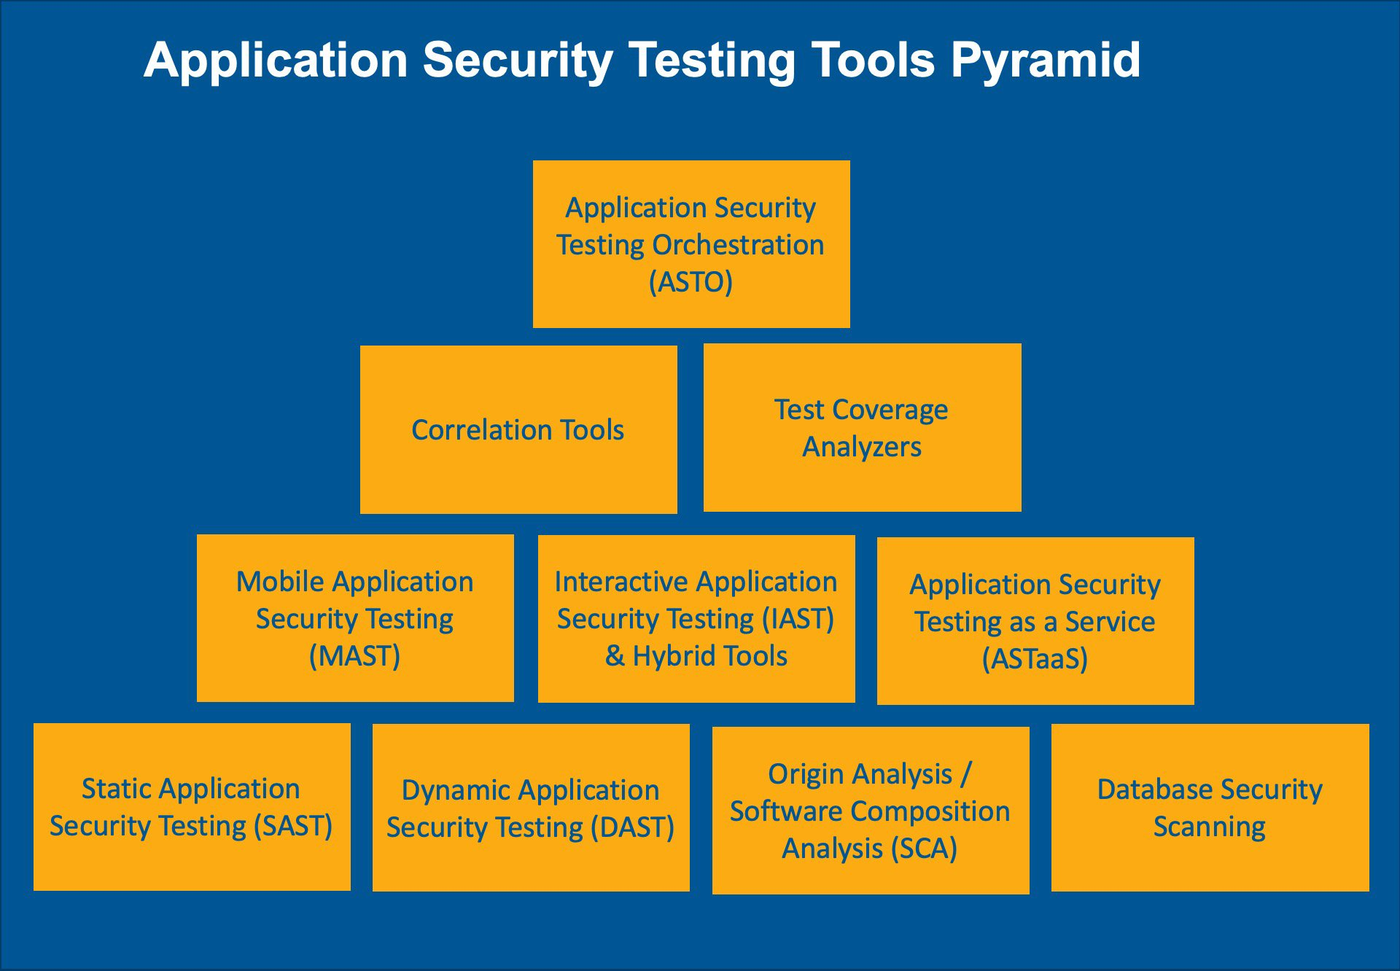
HOW TO MITIGATE?
Use more SAST Analyzes to investigate source code
SCA can be essential for finding problems in OpenSource libraries like LOG4J
IaC Scanner can help find problems like exposed keys
API Scanner May Show Security Flaws Like Missing JWT Token
Container analysis can show problems with the Image and possible exposures
DAST to analyze vulnerabilities from the attacking side
INTEGRATIONS

Slide 15
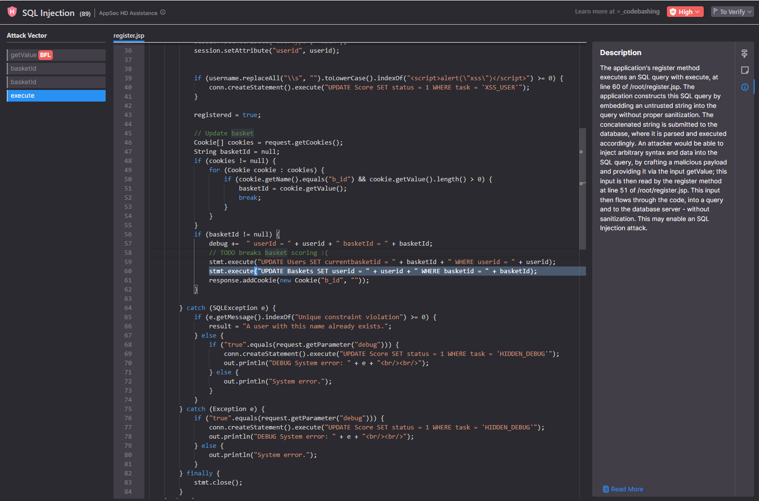
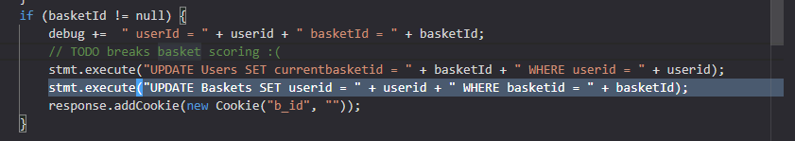
EXAMPLES
In this case we can see a SAST analysis, where we have a SQL Injection, we see that the query can be changed causing a big problem in the base where it can be performed an update of all the fields if the attacker so desires
HOW TO MITIGATE?
Do not use dynamically concatenate strings to construct SQL queries
Prefer using DB Stored Procedures for all data access, instead of ad-hoc dynamic queries.
A better solution is to use an ORM library, in order to pre-define and encapsulate the allowed commands enabled for the application. In this way the code plane and data plane should be isolated from each other. Data validation can be performed effectively using a secure library, such as OWASP's Encoder or ESAPI libraries.

Slide 16
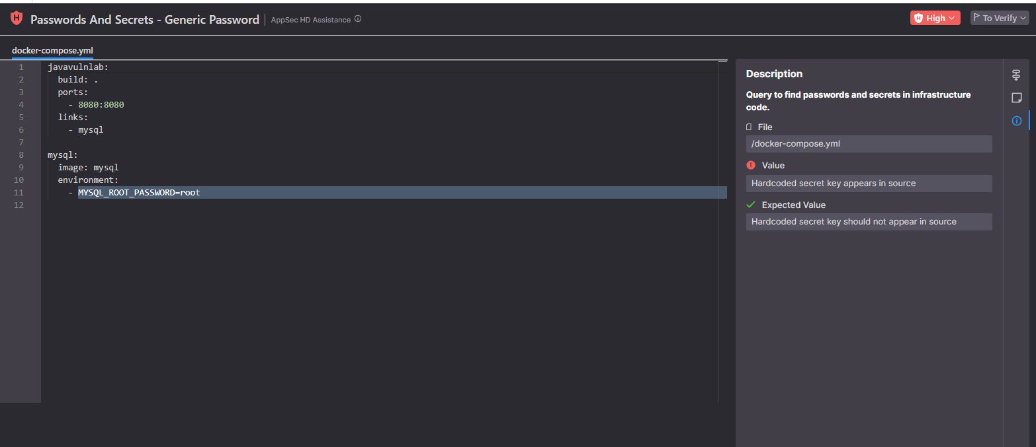
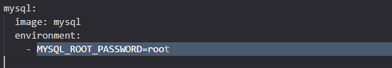
EXAMPLES
In this case we see an IaC analysis, where we can clearly see an "exposed" secret in the code
HOW TO MITIGATE?
We can put it in a secrets file to avoid leakage
We can use a SECRET MANAGER system such as amazon or azure and consume when necessary
Encrypt keys preferably with strong ciphers like sha256 or greater

Slide 17



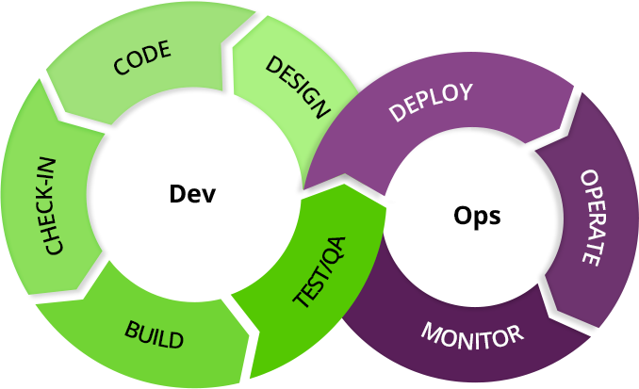












INTEGRATIONS
IDEs
CI/CD (Continuous Integration / Continuous Delivery)
IDE (Integrated Development Environment)
Repositories
Ticket Management
Messengers
Repositórios
Gerenciam Códigos
Build, CI/CD
Bug Tracking
Dashboarding
Data Export API

Slide 18
DEMO

Slide 19
Q&A

Slide 20


Marcos Santos
Phone: +49 179 2210542
Email: marcos.santos@nova-8.com
www.nova8.com.br
To create a slide
Choose a layout style and duplicate the slide. We recommend duplicating the slide so all visible elements are copied from the Master Slide.

